Slide 1

Heart Disease Diagnostic Analysis
Powerbi | Python

Slide 2
Project Details
Title | Heart Disease Diagnostic Analysis
Technologies | Business Intelligence
Domain | Healthcare & Cardiovascular Health
Project Difficulties level | Intermediate
Programming language used | Python
Others tools | PowerBi, Excel, Colab Notebook, MS power point

Slide 3
Problem statement
Heart disease remains a leading cause of mortality worldwide, highlighting the critical need for effective diagnostic tools and prevention strategies. However, the complexity of cardiovascular health and the multitude of factors influencing heart disease diagnosis pose significant challenges for healthcare professionals. In this context, the problem statement revolves around leveraging data analytics to identify key risk factors, patterns, and trends associated with heart disease diagnostics. By analyzing demographic and clinical parameters, the objective is to develop insights that aid in early detection, personalized intervention, and improved patient outcomes. Through this analysis, we aim to contribute to the ongoing efforts in combating heart disease and promoting cardiovascular health on a global scale.

Slide 4
Objective
The objective of this analysis is to perform a comprehensive exploration of the dataset, including descriptive statistics, data visualization, correlation analysis, and identification of potential risk factors for heart disease. The goal is to contribute to better understanding, early detection, and prevention strategies for heart disease.
Benefits
Early Detection and Prevention:
Identification of key risk factors for heart disease enables early detection and intervention strategies.
By leveraging insights from the analysis, healthcare professionals can implement targeted prevention measures to reduce the incidence of heart disease.
Improved Patient Outcomes:
Analysis of clinical parameters and diagnostic trends contributes to better patient outcomes and quality of care.
Early detection of heart disease allows for timely medical interventions, leading to improved prognosis and survival rates.

Slide 5
3.Data-Driven Decision Making:
Data analysis provides evidence-based insights that guide healthcare decision-making processes.
Healthcare providers can make informed decisions regarding patient management and treatment strategies based on the analysis results.
4.Public Health Impact:
The project has the potential to make a significant impact on public health by raising awareness and promoting proactive measures for heart disease prevention.
By addressing key risk factors and implementing preventive measures, the project contributes to reducing the overall burden of cardiovascular diseases in the population.

Slide 6
Data preparation
Using the available dataset on heart disease diagnostics, data cleaning and preprocessing techniques were applied to handle missing values and outliers. The processed data was then formatted and stored in a CSV file for further analysis using Python libraries such as Pandas and NumPy.

Slide 7
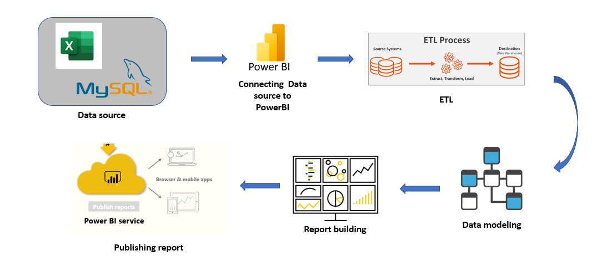
PowerBI Architecture
Overall architecture of the project, which was used to build the dashboard

Slide 8
Dataset Information
Provided Dataset:
Heart Disease data: It consists of list of 1024 rows of data and 14 Attribute they are age, sex, cp, trestbps, chol, fbs, restecg, thalach, exang, oldpeak, slope, ca, thal and target.
Attribute Information:
Age
Sex
(cp) chest pain type (4 values)
(trestbps) resting blood pressure
(chol)serum cholesterol in mg/dl
(fbs)fasting blood sugar > 120 mg/dl
(restecg)resting electrocardiographic results (values 0,1,2)
(thalach)maximum heart rate achieved
(exang)exercise induced angina

Slide 9
oldpeak = ST depression induced by exercise relative to rest
the slope of the peak exercise ST segment
(ca)number of major vessels (0-3) colored by flourosopy
thal: 0 = normal; 1 = fixed defect; 2 = reversable defect
target = 0 absence of heart disease target = 1 presence of heart disease

Slide 10
Populated Dataset:
Final Heart Disease data:
Age: The age of the patient.
CP (Chest Pain): Type of chest pain experienced by the patient (0 for typical angina, 1 for atypical angina, 2 for non-anginal pain, 3 for asymptomatic).
Blood Pressure: Resting blood pressure of the patient (in mm Hg).
Cholesterol: Cholesterol level of the patient (in mg/dl).
FBS (Fasting Blood Sugar): Fasting blood sugar > 120 mg/dl (1 for true, 0 for false).
RestECG (Resting Electrocardiographic Results): Results of resting electrocardiography (0 for normal, 1 for having ST-T wave abnormality, 2 for showing probable or definite left ventricular hypertrophy by Estes' criteria).
Max Heart Rate: Maximum heart rate achieved during exercise.
Exang (Exercise-Induced Angina): Exercise-induced angina (1 for yes, 0 for no).

Slide 11
Oldpeak: ST depression induced by exercise relative to rest.
Slope: Slope of the peak exercise ST segment (0 for upsloping, 1 for flat, 2 for downsloping).
CA (Number of Major Vessels): Number of major vessels colored by fluoroscopy (0-3).
Thal: Thalassemia type (0 for normal, 1 for fixed defect, 2 for reversable defect).
Heart Disease: Presence or absence of heart disease (Absence or Presence).
Gender: Gender of the patient (Male or Female).
Age Range: Age range of the patient (Middle Age or Elder Age).
Chest Pain: Type of chest pain experienced by the patient (Typical Angina).

Slide 12
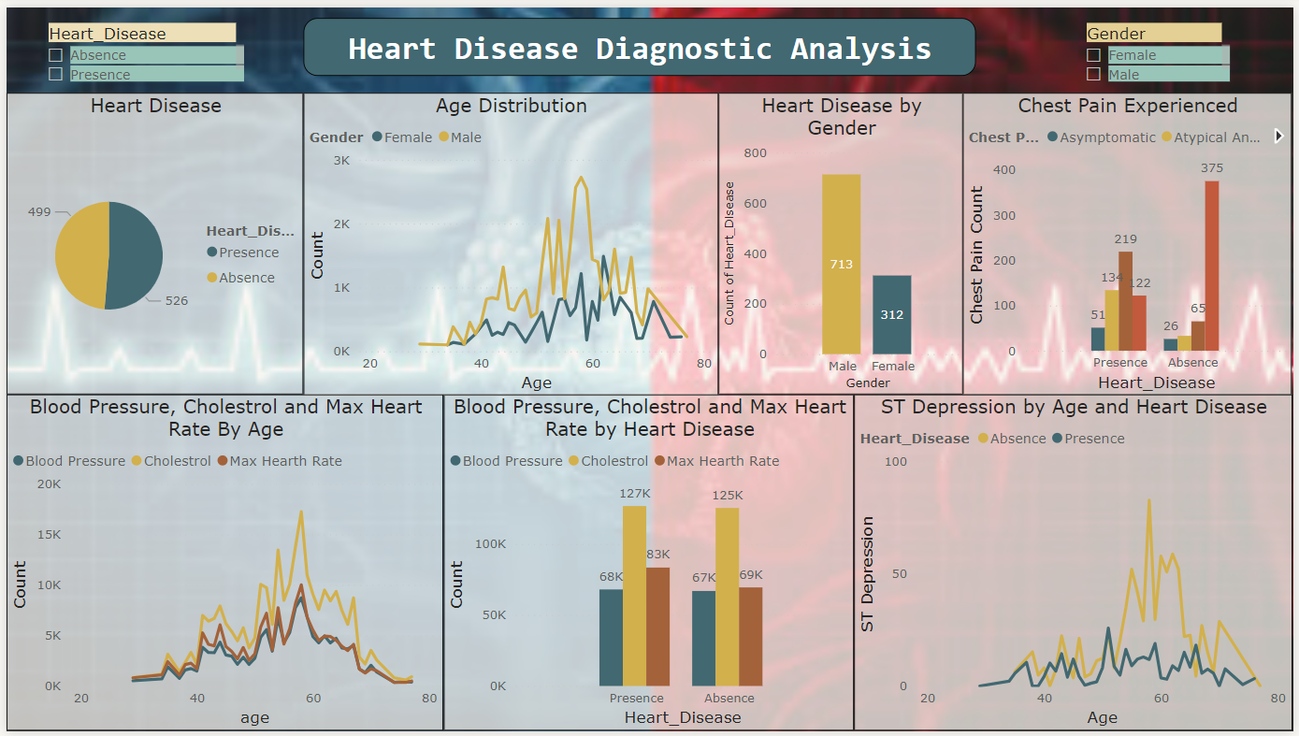
Heart Disease Diagnostic Analysis

Slide 13
KPIs (Key Performance Indicators)
Age of Patients with Heart Disease
Distribution of Heart Disease by Gender
Difference type of chest pain experienced
Blood pressure, cholesterol level and Max heart rate by age
ST Depression levels by age and heart disease

Slide 14


